Slide 1
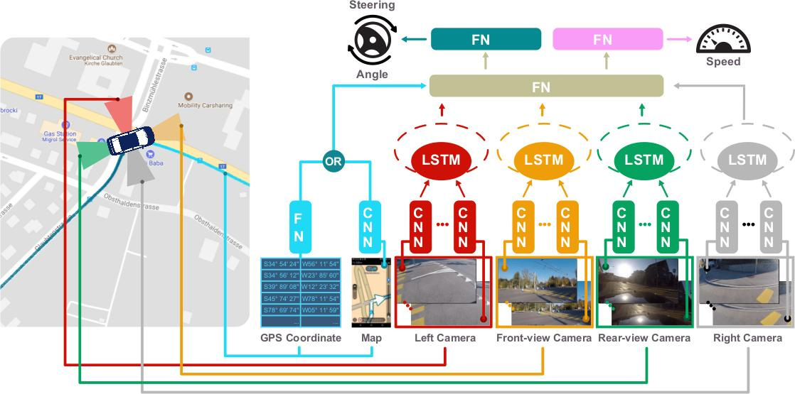
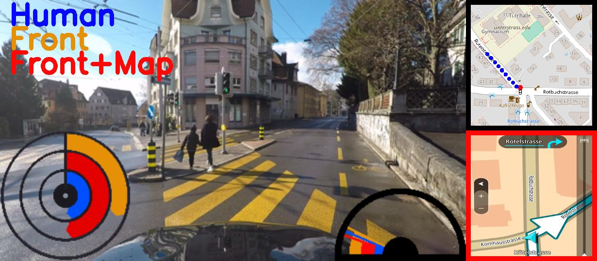
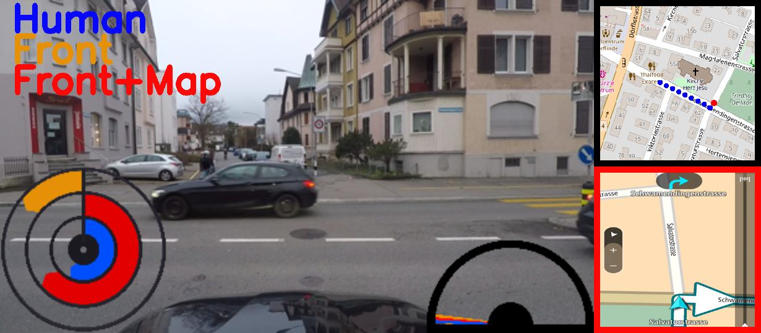
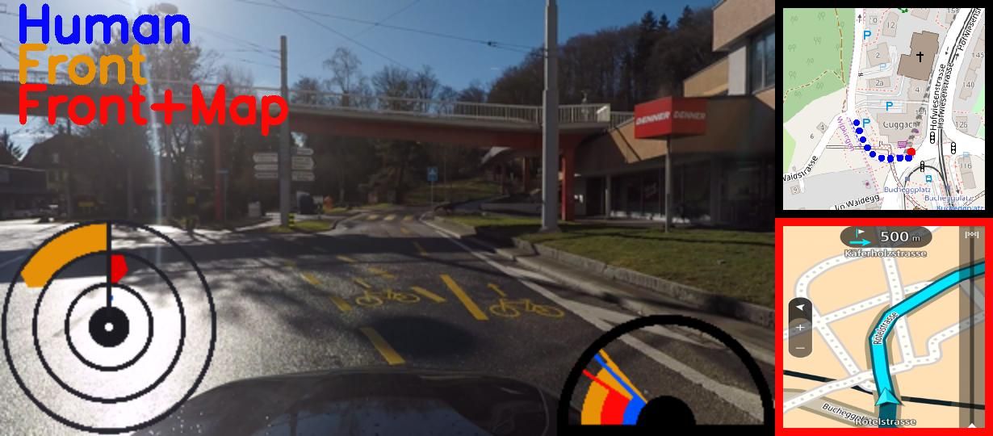
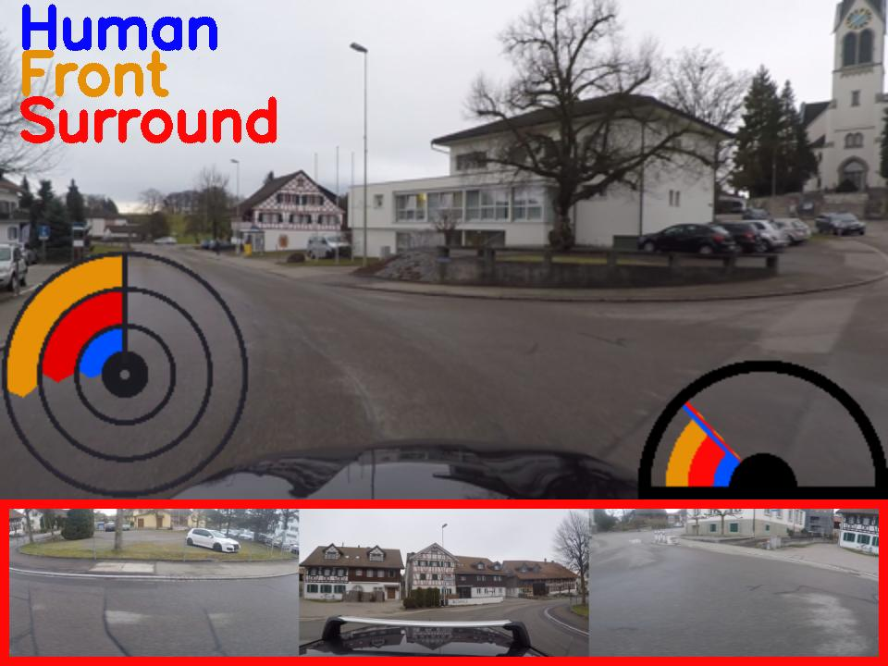
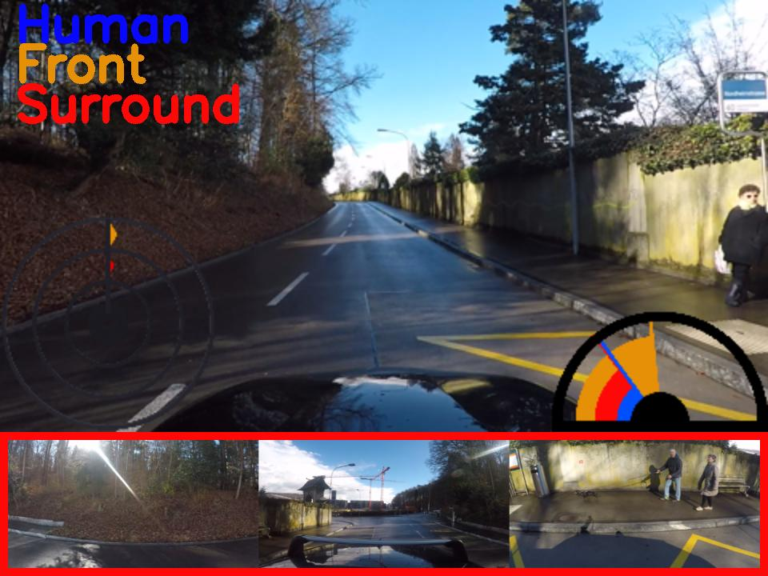
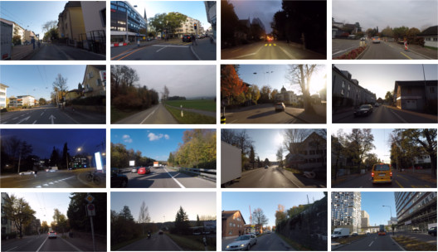
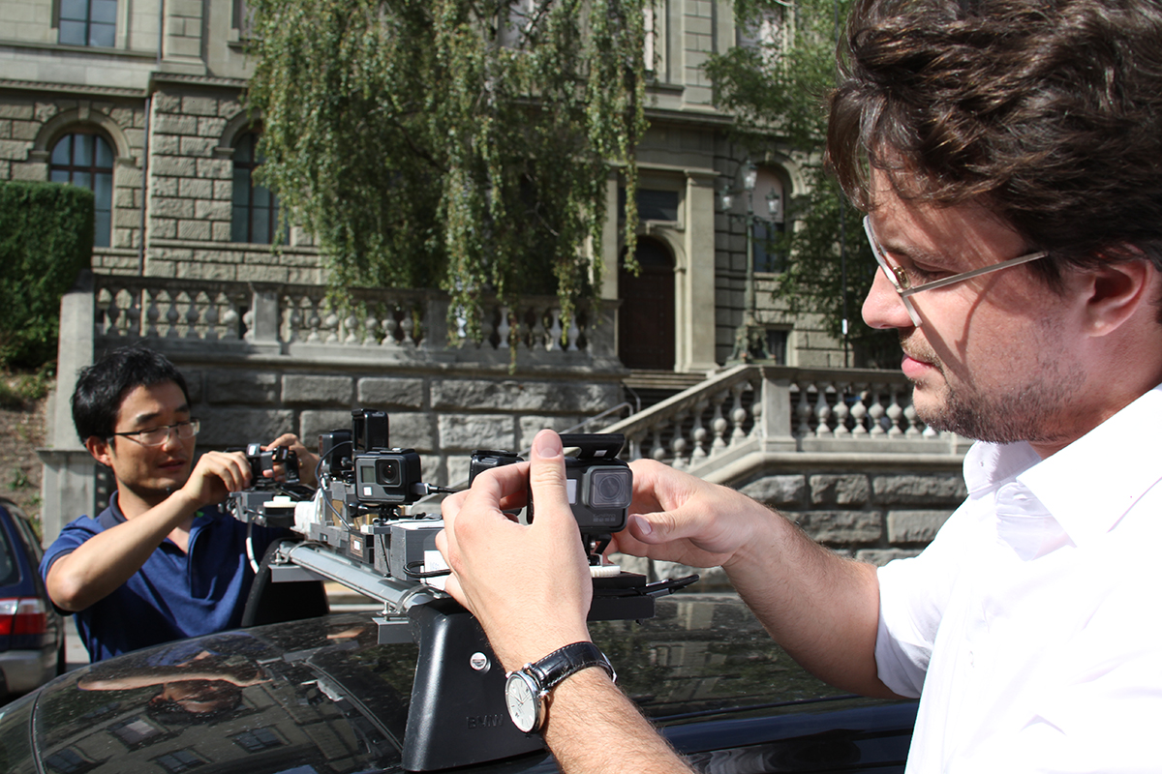
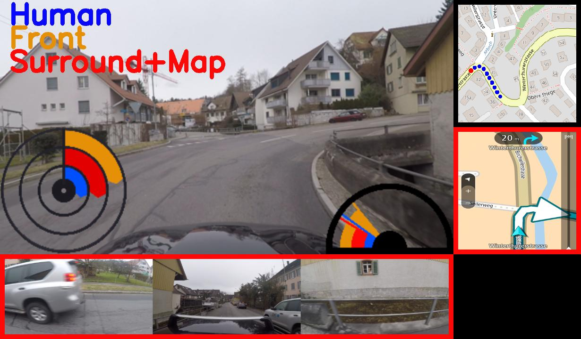
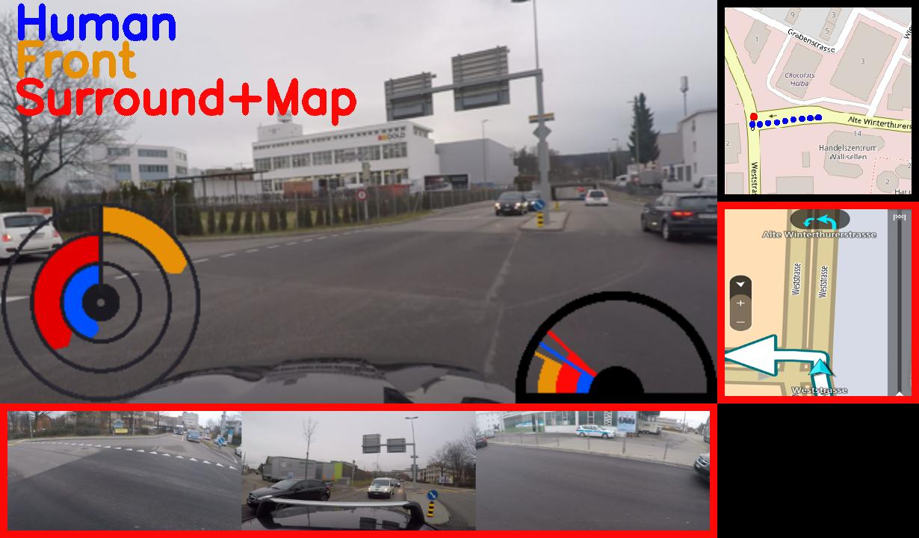
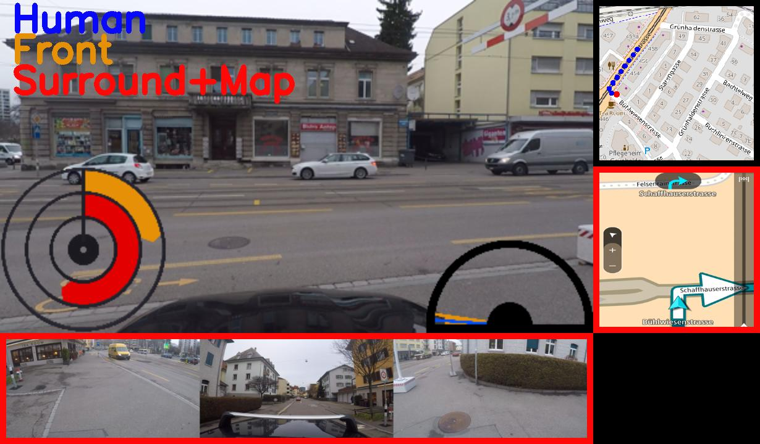
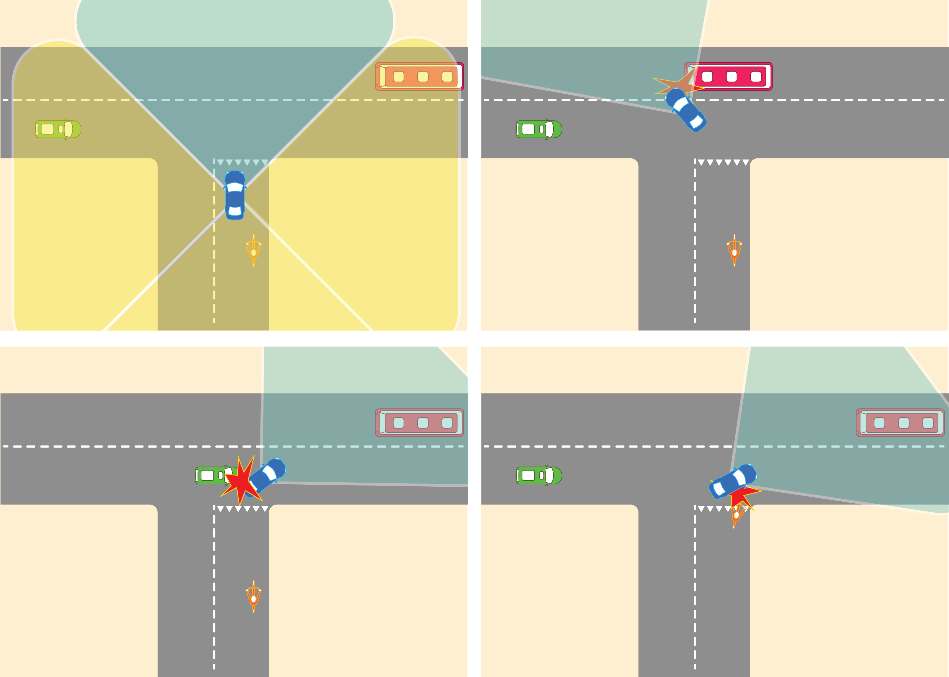
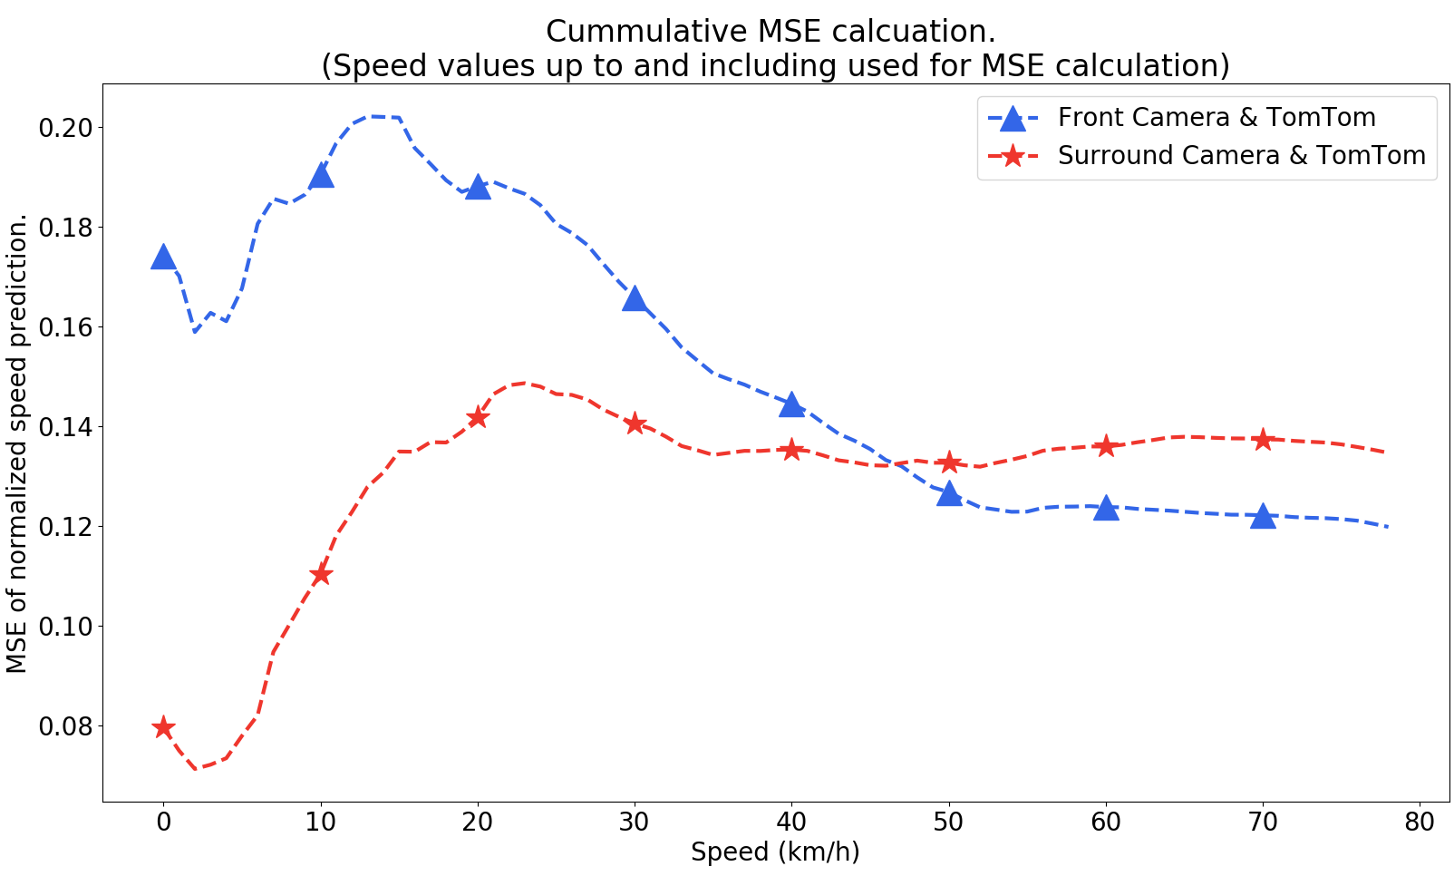
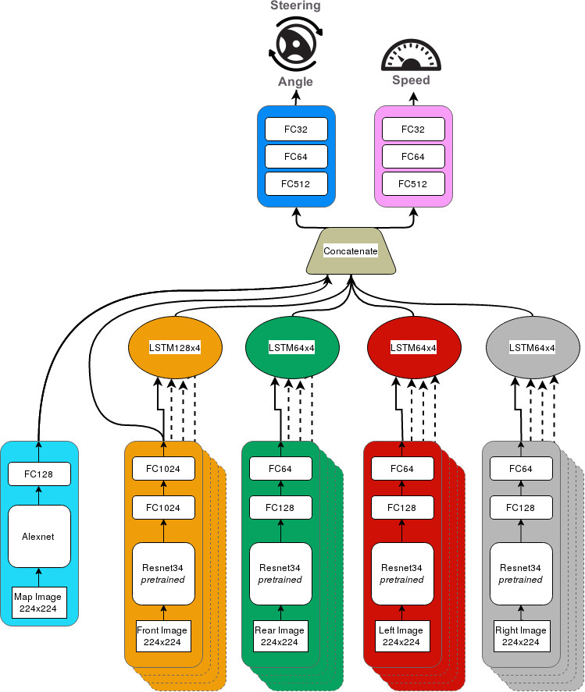
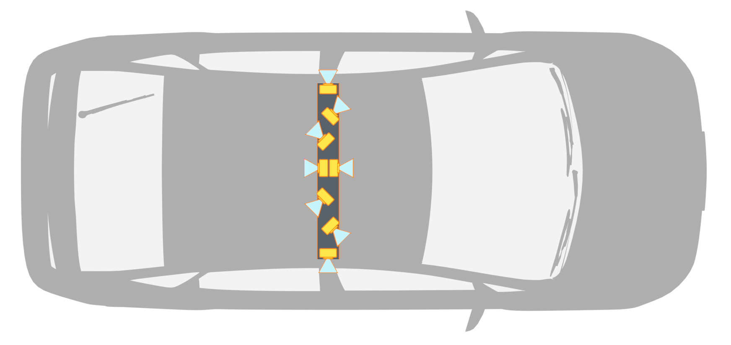
End-to-End Learning of Driving Models with Surround-View Cameras and Route Planners
Simon Hecker, Dengxin Dai, and Luc Van Gool
Computer Vision Lab, ETH Zurich
Dataset & Code
Motivation
Method
Experimental Results
Previous methods only use a front-facing camera
Surround-view cameras mimic side-view and rear-view mirrors, vital for learning driving models
Map (Route Planner) is important for navigation, but not exploited in published work for driving models
Overall Performance
We propose learning driving models in real world settings with a `complete’ sensor configuration
Ablation Study
Dataset
Implementation Details:
Learning to drive via imitation learning. Predict human driving maneuver (steering wheel angle and vehicle speed) for a diverse set of maneuvers based on video data and route planning data.
Learning driving models in a fully end-to-end manner: resnet34 as visual encoder, two fully connected regression networks for steering angle and vehicle speed prediction.
Simultaneous learning of control via normalized maneuver labels.
Dataset:
60 Hours of driving.
Diverse weather conditions, day/night time and road situations (city, countryside, highway).
Sensors:
8 x GoPro Hero 5 cameras @ 60Hz with 1080p and full 360 degree coverage.
TomTom and OpenStreetMap route planning representations.
Low-level CAN bus maneuver recording including steering wheel angle and vehicle speed.
GPS & IMU odometry.
Surround-view Cameras
Learning Details
Using historical steering angle ,
historical speed , historical vehicle trajectory , video
data , planned route to predict future speed ,
and steering angle
TomTom
OSM
Map helps significantly, esp. for steering prediction
TomTom route planner outperforms OSM planner
Multiple cameras help esp. for low-speed, city driving and driving at intersections
This work is funded by Toyota Motor Europe via the project TRACE-Zurich

